Slide 1


Capstone Project Phase A smell Classification and Identification 24-1-R-1
Amit Malca
Liel Pasman
Supervisor: Mr. Ilya Zeldner

Slide 2

Introduction
Importance of smell analysis
Perfumery and Cosmetics
Food industry
Technology and Communication
1
Introduction
Importance of smell analysis

Slide 3
Introduction
The problem
Smell absorption
Smell identification and characterization analysis
Preparing the output for the input the smell creation phase
Create new smell
1
2
Introduction
Importance of smell analysis
Introduction
The problem

Slide 4
Introduction
Our solution
Classification smells
Using deep learning algorithms
Application
1
2
3
Introduction
Importance of smell analysis
Introduction
The problem
Introduction
Our solution

Slide 5
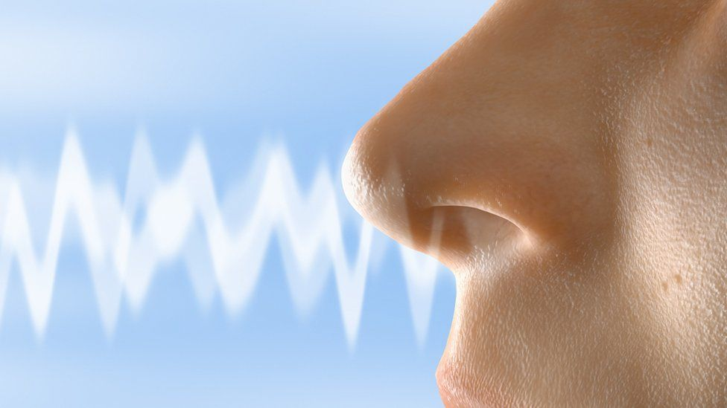
BackGround
Conditions for a molecule to be called an odorant
Lack of uniformity in smell analysis
1
2
3
4
Introduction
Importance of smell analysis
Introduction
The problem
Introduction
Our Solution
BackGround

Slide 6
BackGround
Previous Researches
Imbalance in the databases
Using chemical prediction techniques with limitations in interpretation.
Limiting the comparison and classification of only two smells at a time.
1
2
3
4
5
Introduction
Importance of smell analysis
Introduction
The problem
Introduction
Our Solution
BackGround
BackGround
Previous Researches

Slide 7
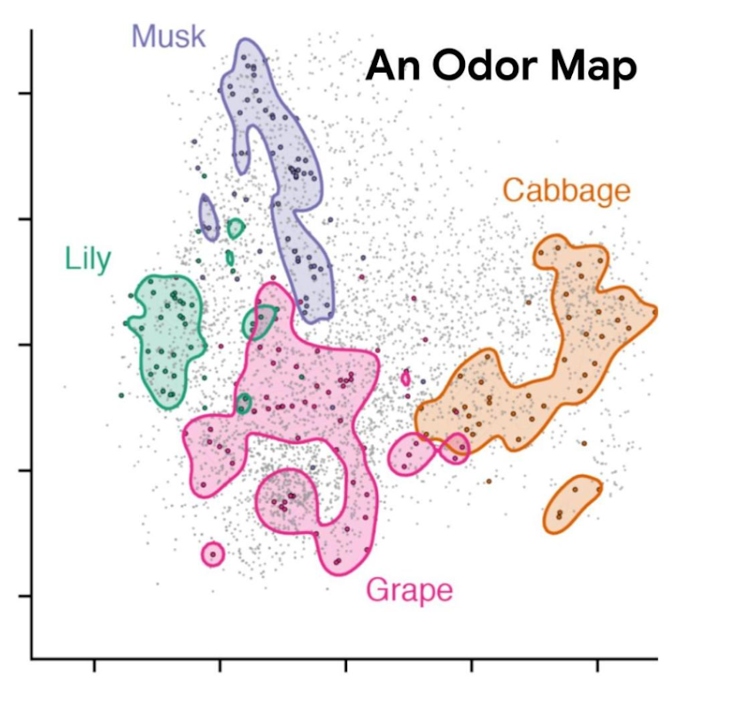
BackGround
POM-Principal Odor Map
1
2
3
4
5
6
Introduction
Importance of smell analysis
Introduction
The problem
Introduction
Our Solution
BackGround
BackGround
Previous Researches
BackGround
POM

Slide 8
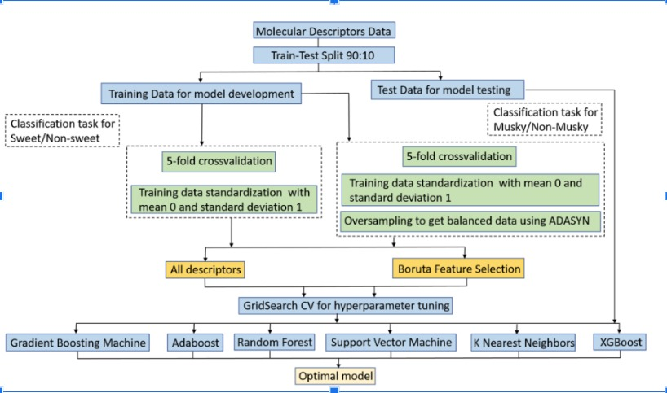
Architecture
Ensemble Learning
1
2
3
4
5
6
7
Introduction
Importance of smell analysis
Introduction
The problem
Introduction
Our Solution
BackGround
BackGround
Previous Researches
BackGround
POM
Architecture
8

Slide 9
Performance of Classification Algorithms
for "Sweet" and "Musky" OC Labels:
Algorithm | Train F1-Score | Validation F1-Score | Test F1-Score
Gradient Boosting | 0.816 | 0.785 | 0.813
AdaBoost | 0.789 | 0.768 | 0.823
Random Forest | 0.818 | 0.785 | 0.824
Support Vector Machine | 0.754 | 0.732 | 0.781
XGBoost | 0.799 | 0.774 | 0.84
K-Nearest Neighbors | 0.784 | 0.773 | 0.838
1
2
3
4
5
6
7
Introduction
Importance of smell analysis
Introduction
The problem
Introduction
Our Solution
BackGround
BackGround
Previous Researches
BackGround
POM
Architecture

Slide 10
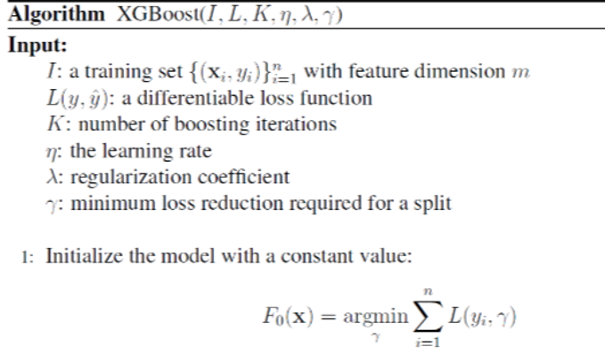
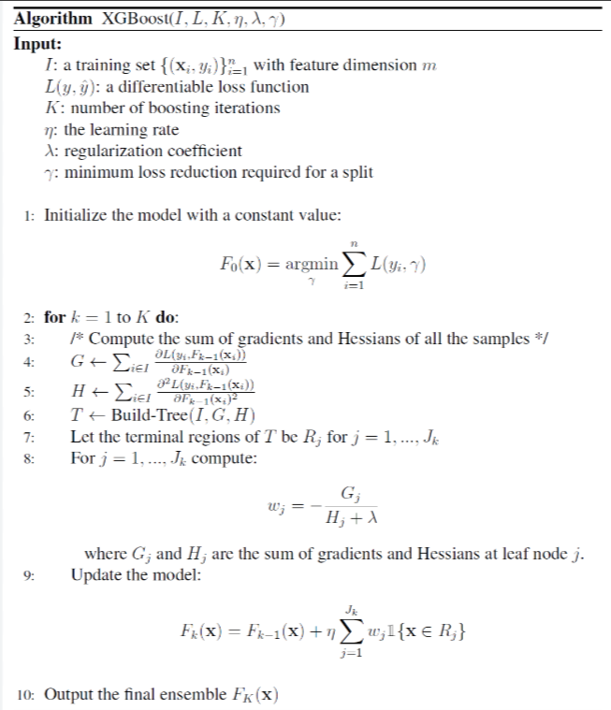
XGBoost
1
2
3
4
5
6
7
8
Introduction
Importance of smell analysis
Introduction
The problem
Introduction
Our Solution
BackGround
BackGround
Previous Researches
BackGround
POM
Architecture
XGBoost

Slide 11
Database
medicinal
melon
metallic
milky
musk
fishy
floral
fresh
fruit
skin
1
2
3
4
5
6
7
8
9
Introduction
Importance of smell analysis
Introduction
The problem
Introduction
Our Solution
BackGround
BackGround
Previous Researches
BackGround
POM
Architecture
XGBoost
Database

Slide 12
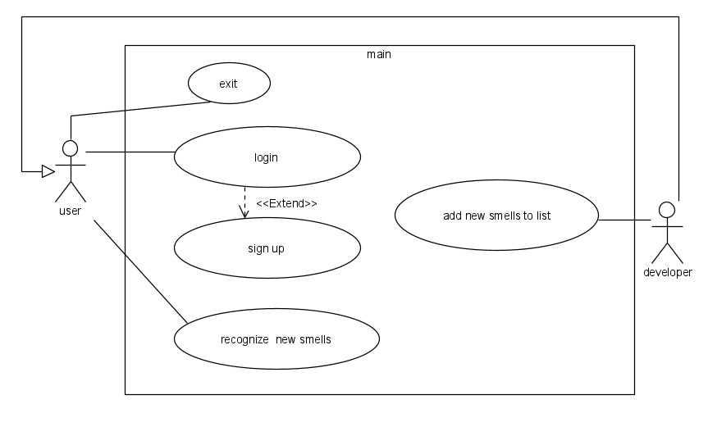
Our App-”Smelltify”
Use Case Diagram
1
2
3
4
5
6
7
8
9
10
Introduction
Importance of smell analysis
Introduction
The problem
Introduction
Our Solution
BackGround
BackGround
Previous Researches
BackGround
POM
Architecture
XGBoost
Database
Our App-”Smelltify” Use Case Diagram

Slide 13
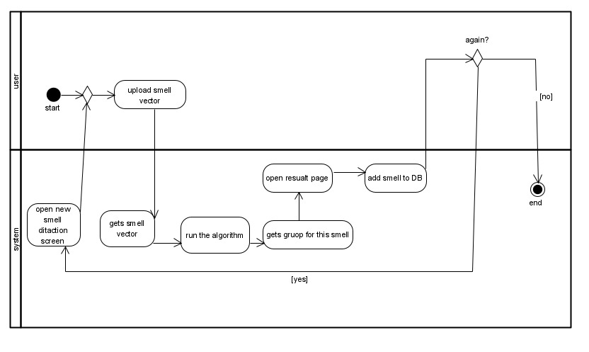
Our App-”Smelltify”
Activity Diagram
1
2
3
4
5
6
7
8
9
10
11
Introduction
Importance of smell analysis
Introduction
The problem
Introduction
Our Solution
BackGround
BackGround
Previous Researches
BackGround
POM
Architecture
XGBoost
Database
Our App-”Smelltify” Use Case Diagram
Our App-”Smelltify” Activity Diagram

Slide 14
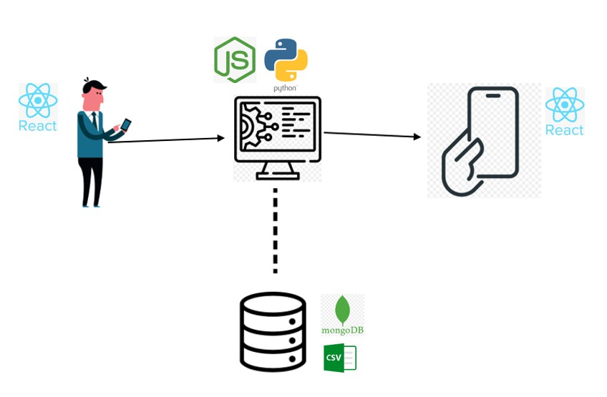
Architecture and Technologies
1
2
3
4
5
6
7
8
9
10
11
12
Introduction
Importance of smell analysis
Introduction
The problem
Introduction
Our Solution
BackGround
BackGround
Previous Researches
BackGround
POM
Architecture
XGBoost
Database
Our App-”Smelltify” Use Case Diagram
Our App-”Smelltify” Activity Diagram
Architecture and Technologies

Slide 15
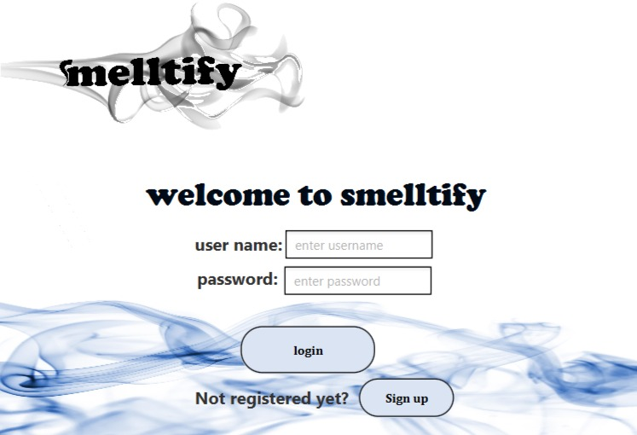
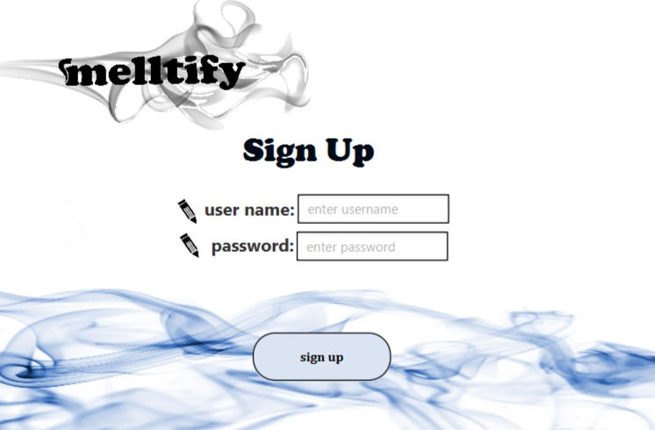
Our App-”Smelltify”
1
2
3
4
5
6
7
8
9
10
11
12
13
Introduction
Importance of smell analysis
Introduction
The problem
Introduction
Our Solution
BackGround
BackGround
Previous Researches
BackGround
POM
Architecture
XGBoost
Database
Our App-”Smelltify” Use Case Diagram
Our App-”Smelltify” Activity Diagram
Architecture and Technologies
“Smelltify”

Slide 16
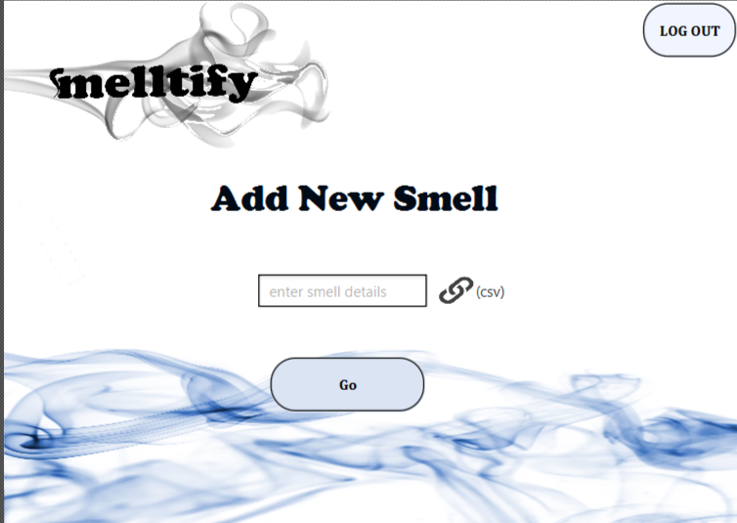
Our App-”Smelltify”
1
2
3
4
5
6
7
8
9
10
11
12
13
Introduction
Importance of smell analysis
Introduction
The problem
Introduction
Our Solution
BackGround
BackGround
Previous Researches
BackGround
POM
Architecture
XGBoost
Database
Our App-”Smelltify” Use Case Diagram
Our App-”Smelltify” Activity Diagram
Architecture and Technologies
“Smelltify”

Slide 17
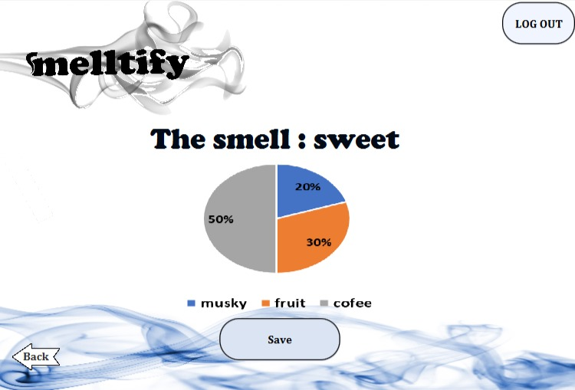
Our App-”Smelltify”
1
2
3
4
5
6
7
8
9
10
11
12
13
Introduction
Importance of smell analysis
Introduction
The problem
Introduction
Our Solution
BackGround
BackGround
Previous Researches
BackGround
POM
Architecture
XGBoost
Database
Our App-”Smelltify” Use Case Diagram
Our App-”Smelltify” Activity Diagram
Architecture and Technologies
“Smelltify”

Slide 18
Our App-”smelltify”
Verification Plan
Utilizing Known Odors
Distance Function Application
Principal Odor Map (POM(
1
2
3
4
5
6
7
8
9
10
11
12
13
14
Introduction
Importance of smell analysis
Introduction
The problem
Introduction
Our Solution
BackGround
BackGround
Previous Researches
BackGround
POM
Architecture
XGBoost
Database
Our App-”Smelltify” Use Case Diagram
Our App-”Smelltify” Activity Diagram
Architecture and Technologies
“Smelltify”
Our App- Verification Plan

Slide 19
Our App-”smelltify”
Verification Plan
Expected Result | Test Description | #
Error message to the user:"Wrong in the details" There is an error in username or password" | Error in input data at LogInScreen:wrong user name /password/both | 1
Error message to the user:" The user is already registered" | Error in input data at LogInScreen:user is not registered | 2
Showing “AddNewSmell” screen | Right input data at the LogInScreen: the user is registered and entered right data | 3
Error message to the user:" The user is already registered" | Error in input data at the RegisterScreen: The user is already registered | 4
Error message to the user:"Wrong in the details" There is an error in username or password or email" | Error in input data at LogIn RegisterScreen:wrong user name /password /both | 5
1
2
3
4
5
6
7
8
9
10
11
12
13
14
Introduction
Importance of smell analysis
Introduction
The problem
Introduction
Our Solution
BackGround
BackGround
Previous Researches
BackGround
POM
Architecture
XGBoost
Database
Our App-”Smelltify” Use Case Diagram
Our App-”Smelltify” Activity Diagram
Architecture and Technologies
“Smelltify”
Our App- Verification Plan

Slide 20
Challenges
Challenges in the Next Phase
Algorithm Implementation
Algorithm verification
Lack of time
1
2
3
4
5
6
7
8
9
10
11
12
13
14
15
Introduction
Importance of smell analysis
Introduction
The problem
Introduction
Our Solution
BackGround
BackGround
Previous Researches
BackGround
POM
Architecture
XGBoost
Database
Our App-”Smelltify” Use Case Diagram
Our App-”Smelltify” Activity Diagram
Architecture and Technologies
“Smelltify”
Our App- Verification Plan
Challenges

Slide 21
Thank you for listening

Slide 22
References
Gerkin, R. C., & Wiltschko, A. B. (2022). Digitizing smell: Using molecular maps to understand odor. Google AI Blog.
Chacko, R., Jain, D., Patwardhan, M., Puri, A., Karande, S., & Rai, B. (2020). Data based predictive models for odor perception. *Scientific Reports*. https://doi.org/10.1038/s41598-020-73978-1
. https://www.kaggle.com/datasets/aryanamitbarsainyan/multi-labelled-smiles-odors-dataset/data
. https://towardsdatascience.com/xgboost-the-definitive-guide-part-1-cc24d2dcd87a

